Slide 1


A
Research Report On
“A STUDY ON AWARENESS OF CRYPTOCURRENCY AMONG INDIAN CONSUMERS”
In the partial fulfilment for the award of the Degree of
MASTER OF BUSINESS ADMINISTRATION
Under the guidance of
Mr.Akash Gautam
Associate Professor
Submitted By Arpit Namdeo
MBA IV SEM.
Roll No. - 21131654
GYAN GANGA COLLEGE OF TECHNOLOGY, JABALPUR (M.P.)
Submitted To
RANI DURGAVATI VISHWAVIDALAYA, JABALPUR (M.P.)
YEAR: 2023

Slide 2
Index
Executive Summary | 03
Introduction | 04
Company Profile | 05-6
Objective of the study | 07
Research Methodology | 08
Data Analysis and Interpretation | 09-18
Findings | 19
Conclusion | 20
Suggestions | 21

Slide 3
The main aim and objective of this study is to find the consumer’s perception towards Cryptocurrency, with special reference to Jabalpur. And to find out the types of levels Of opinions, attitudes, and perception of consumers various cryptocurrencies. The main basis on which consumer perception is analysed is awareness, ownership, and other survey questions regarding knowledge of the cryptocurrency.
EXECUTIVE SUMMARY
Customer perception is the opinions, feelings, and beliefs customers have about digital currency. It plays an important role in buying the digital currencies and retention as well as currency reputation and awareness. This study is conducted to determine how people feel about cryptocurrency market. The goal is to gather as much information as possible.

Slide 4

INTRODUCTION
Perception:
Perception refers to the process of recognizing, interpreting, and making sense of sensory information received from the environment. It involves the way we acquire, organize, and interpret information through our senses, such as sight, hearing, touch, taste, and smell. Perception plays a crucial role in how we understand and interact with the world around us.
Consumer Perception:
Consumer perception refers to how individuals perceive and interpret various aspects of products, services, brands, or companies in the context of their consumer experiences. It involves the subjective opinions, beliefs, attitudes, and impressions that consumers develop based on their interactions and exposure to marketing stimuli.

Slide 5
Cryptocurrency, a digital or virtual form of currency, has gained significant popularity and adoption worldwide. In India, where the cryptocurrency landscape is evolving, it is crucial to understand the level of awareness among the population. This report delves into the current state of cryptocurrency in India, focusing on its regulatory framework, government stance, and existing cryptocurrency exchanges and trading platforms. The study employed a mixed-methods approach, combining surveys, interviews, and secondary research. Random sampling from diverse regions and demographics ensured a representative sample. Quantitative data analysis provided statistical insights, while qualitative analysis helped capture subjective perceptions and attitudes. The report highlights that the level of awareness about cryptocurrencies in India varies among the population. While some individuals possess a good understanding of the functioning, technology, and potential applications of cryptocurrencies, others lack comprehensive knowledge. Factors influencing awareness and adoption include socioeconomic variables, media coverage, and educational initiatives
What is Cryptocurrency?

Slide 6

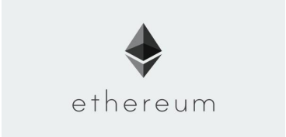
Types Of Crypto Currencies
Bitcoin (BTC): Bitcoin is the first and most well-known cryptocurrency, created by an unknown person or group of people using the pseudonym Satoshi Nakamoto in 2009. It operates on a decentralized peer-to-peer network called the blockchain and is mainly used as a store of value and a medium of exchange.
Ethereum (ETH): Launched in 2015, Ethereum is a decentralized platform that enables developers to build and deploy smart contracts and decentralized applications (DApps). Ether (ETH) is the native cryptocurrency of the Ethereum network and is
used for transaction fees and computational services.
Ripple (XRP): Ripple is a digital payment protocol and cryptocurrency that aims to facilitate cross-border transactions for financial institutions. It focuses on fast and low-cost international money transfers

Slide 7
04. OBJECTIVE OF THE STUDY
1. To know the customer’s awareness regarding cryptocurrency.
02.To analyse the customer behaviour towards cryptocurrency.
3. To find out the customer’s perception towards cryptocurrency.

Slide 8
RESEARCH METHODOLOGY
Research:
The methodology for the research study used are:
Quantitative Research
Qualitative Research
SOURCES OF DATA COLLECTED
Primary data
Questionnaire survey method is applied. On the random respondents.
Secondary data
Data collected from online sites
Sampling:
Sampling here
Sample size : 64
Sample area : Jabalpur
RESEARCH METHODOLOGY

Slide 9
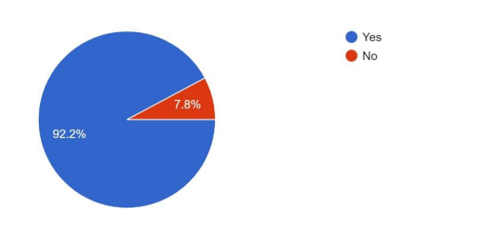
1. Are you aware about cryptocurrency like Bitcoin, Etherium and Ripple?
DATA ANALYSIS & INTERPRETATION
Interpretation:
As we can see that in the above figure total 64 people have responded and out of them 92.2% respondents are aware about the cryptocurrencies.
7.8% says that they have no idea about the cryptocurrency.

Slide 10
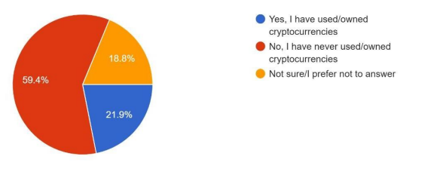
2. Have you ever used or owned cryptocurrency?
Interpretation:
21.9% respondents says that they have owned/used cryptocurrency.
59.4%respondents have not used/owned cryptocurrency.
18.8% respondents does not prefer to answer.

Slide 11
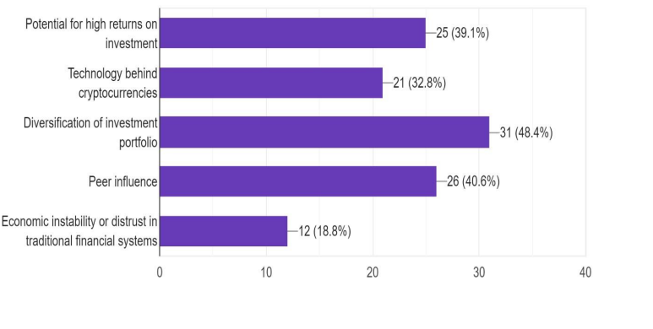
3. What influenced your decision to invest in cryptocurrency?(Select all that apply)
Interpretation:
39.1% (29) respondents opted that cryptocurrency have potential of high returns.
32.8% (21) respondents thought that cryptocurrency is technically advanced. 48.4% (31) respondents like diversification of investment portfolio.
0.6% (26) respondents are influenced by their peer.
18.8%(12) respondents invested because of their distrust in traditional financial system

Slide 12
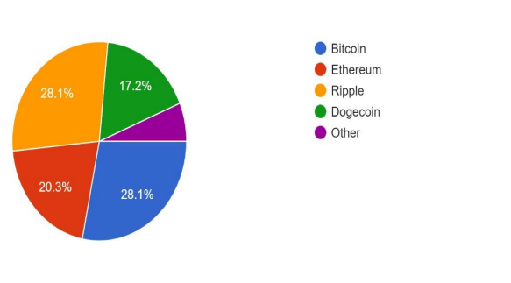
4. Which cryptocurreny do you find most appealing?
Interpretation:
28.1% respondents prefer bitcoin which also one of the famous bitcoin the world.
28.1% respondents prefer Ripple.
20.3% respondents prefer Ethereum which is considered one of the sagest after the Bitcoin.
17.2% respondents prefer Dogecoin.
So, most respondents prefer Bitcoin and Ripple as they also invested in these currencies

Slide 13
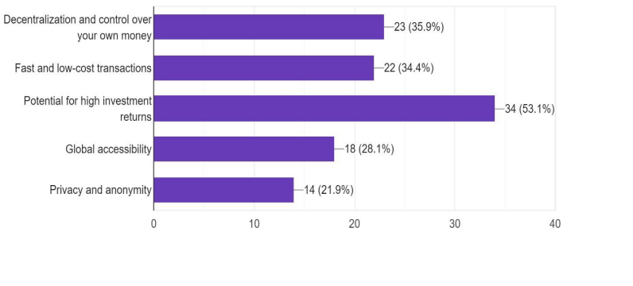
5. What do you perceive as the main advantages of cryptocurrency ?(Select all that apply)
Interpretation:
35.9% (23) respondents thinks that decentralization and control over own money is good.
34.4% (22) respondents thinks that transactions in cryptocurrency is fast and low-cost.
53.1% (34) respondents thinks for potential for high investment returns.
28.1% (18) thinks that they have global accessibility.
21.9%(14) thinks that privacy and anonymity.

Slide 14
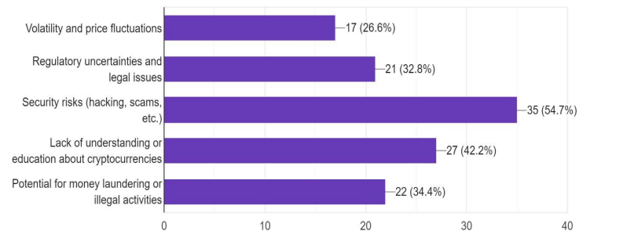
6. What concerns or risks do you associate with cryptocurrency?(Select all that apply)
Interpretation:
26.6% (17) thinks that volatility and price fluctuations.
23.8% (21) thinks that regulatory uncertainties and legal issues is a big concern.
54.7% (35) thinks that cryptocurrency have security risks (hacking, scams, etc).
42.2% (27) thinks that people do not have education about cryptocurrencies. 34.4% (22) thinks that people can use cryptocurrency fir their illegal activities

Slide 15
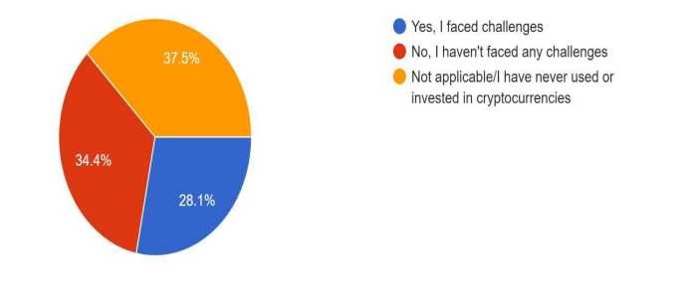
Interpretation: (a) 28.1 % respondents say that they have faced problems in using cryptocurrency. (b) 34.4% respondents say that they have not faced any challenges while investing in cryptocurrency. (c) 37.5% respondents say that they have never used or invested in cryptocurrency
7. Have you faced any challenges while investing or using cryptocurrency?

Slide 16
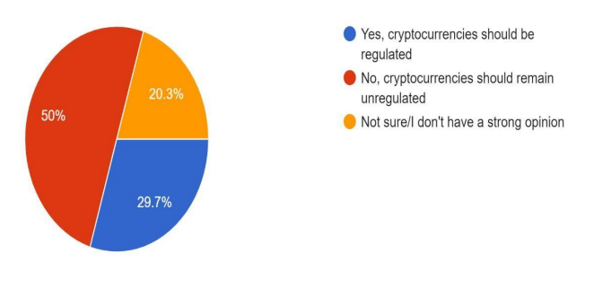
Interpretation: (a) 29.7% respondents support that cryptocurrency should be regulated by government. (b) 50% respondents thought that cryptocurrency should not be regulated by government. (c) 20.3% respondents are not sure.
8. Do you think cryptocurrency should be regulated by government?

Slide 17
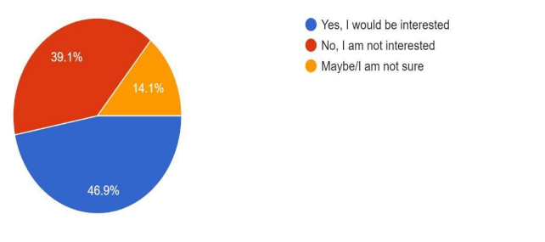
Interpretation: (a) 46.9% respondents would like to learn more about cryptocurrency in future. (b) 39.1% respondents say that they are not interested in learning more about cryptocurrency. (c) 14.1 % respondents are not sure about their interest. The data shows that most people are interested in learning more about cryptocurrency.
9. Would you be interested in learning more about cryptocurrency and how to invest in it safely?

Slide 18
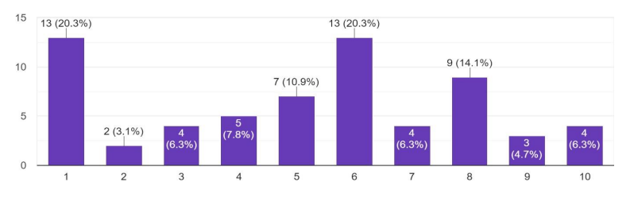
10.On a scale of 1 to 10, how likely are you to recommend cryptocurrencies to others as an investment option?
Interpretation:
20.3% (13) respondents says that they will highly recommend the cryptocurrency to as an investment option to other people.
10.9% (7) respondents says that they are not sure about their opinion.
6.3(4) respondents would not recommend cryptocurrency as an investment option to other people.

Slide 19
FINDINGS
The research is done on the consumer perception on different aspects left us a number of findings. All these findings are, and conclusions are drawn from the questionnaires, which are filled by the respondents through online with the help of Google form:
It is found out that more than 50% people are aware about the cryptocurrency.
21% respondents have owned cryptocurrency, 59% respondents do not own cryptocurrency and 18% does not prefer to say.
48% respondents think that diversification of portfolio is the reason die to which they have invested in cryptocurrency. 28% respondents have trust on Bitcoin and prefer to own it.
35% respondents think that decentralization and control over their own money is the biggest advantage of cryptocurrency.
54% respondents think that cryptocurrency has security risks.
37% respondents say that they have never used or invested in cryptocurrency.
50% respondents say that the cryptocurrency should not be regulated by government.
46% respondents want to learn more about cryptocurrency

Slide 20
CONCLUSION
Mixed Sentiment –
More than half of the participants are aware of cryptocurrency, indicating significant recognition and attention.
Adoption rate remains moderate, with only 21% of respondents claiming ownership of cryptocurrency.
Room for growth and wider acceptance of digital assets in the general population.
Factors Influencing Investment Decisions-
Nearly half of the respondents (48%) invested in cryptocurrency to diversify their investment portfolio.
Growing perception of cryptocurrency as an alternative asset class.
Bitcoin enjoys a higher level of trust, with 28% of respondents expressing a preference for owning it.
Advantages and Concerns-
35% of respondents find appeal in the decentralization and control over their own money.
Positive sentiments are offset by concerns about security risks, as 54% perceive cryptocurrency as having inherent security vulnerabilities.
Education and Awareness-
37% of respondents have never used or invested in cryptocurrency, indicating the need for further education and awareness-building.
Efforts to increase understanding and confidence in this rapidly evolving domain are necessary.
Government Regulation-
Half of the respondents (50%) advocate against government regulation of cryptocurrency, preferring to maintain the decentralized nature of these assets.
Future Trajectory-
Public perception, efforts to address security concerns, and educational initiatives will shape cryptocurrency's future trajectory. Striking a balance between innovation, security, and education is crucial for broader adoption

Slide 21
SUGGESTIONS
Based on the survey data, the following suggestions can be made to address the various aspects related to cryptocurrency adoption and perception:
Education and Awareness-
Strong focus on education and awareness campaigns about cryptocurrency.
Collaboration among governments, financial institutions, and cryptocurrency advocates to create comprehensive educational programs.
Targeting different demographics and easily accessible through online resources, workshops, and educational materials.
Security Measures-
Prioritize robust security measures like multi-factor authentication, cold storage options, and regular security audits.
Instill confidence in users and protect their assets from potential threats.
Balancing Regulation and Innovation-
Establish a regulatory framework that ensures investor protection, prevents fraudulent activities and fosters a fair and transparent cryptocurrency market.
Provide a conducive environment for cryptocurrency growth while safeguarding the interests of users and investors. User-
Friendly Interfaces-
Prioritize user-friendly interfaces. Simplify the process of buying, storing, and transacting with cryptocurrencies.

Slide 22
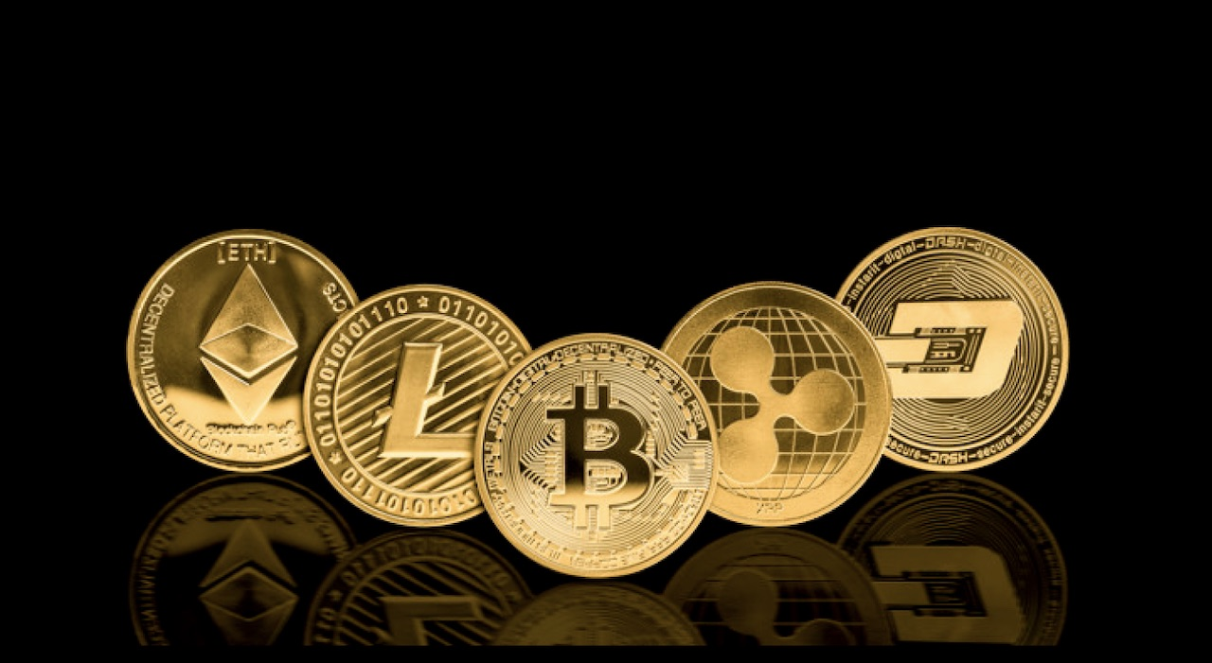
THANK YOU

